Slide 1
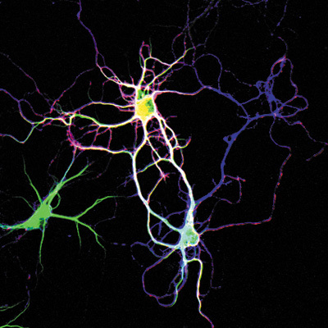
Lesch-Nyhan Syndrome (LNS) and the HPRT1 Gene
Billy Maes

Slide 2
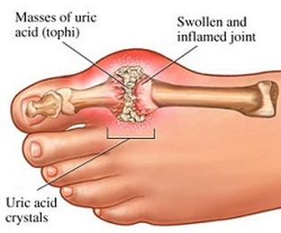
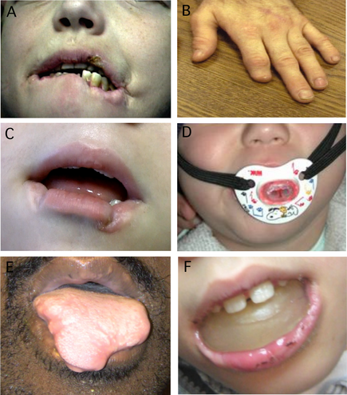
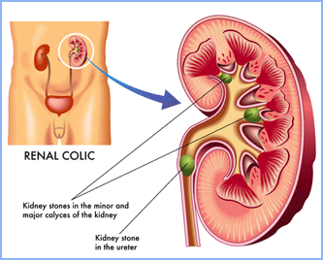
What is Lesch-Nyhan Syndrome?
Gouty arthritis
Kidney stones
Loss of motor control
Cognitive problems
Self-mutilation
Notes:
X-linked recessive disease caused by a severe deficiency of hypoxanthine-guanine phosphoribosyltransferase (HPRT) → recycles purines for reuse as DNA in cells.
HPRT loss causes overproduction of uric acid → gouty arthritis and kidney stones (known mechanism);
Only occur in patients with complete loss of HPRT function (unknown mechanism):
Motor control (involuntary muscle contractions, unable to stand/walk);
Cognitive problems (varying levels of mental retardation)
Self-Injury (biting through lips, tongue, fingers, and other body parts; head banging, eye gouging, etc.)

Slide 3
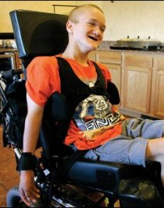
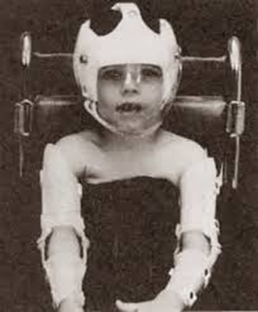
What is Lesch-Nyhan Syndrome?
https://www.youtube.com/watch?v=1U6LDpF_LFE

Slide 4
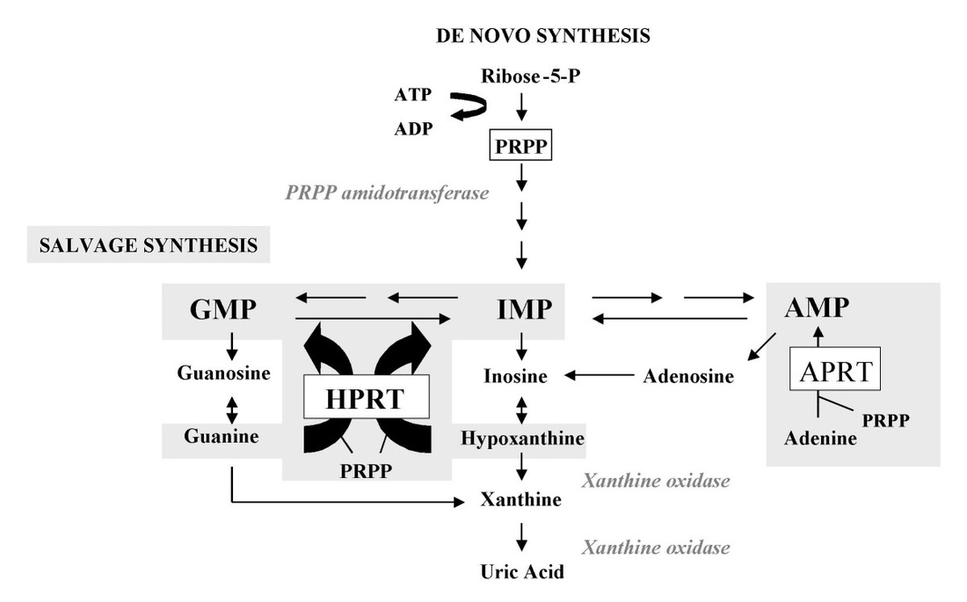
What causes Lesch-Nyhan Syndrome?
Excess uric acid → gout and kidney stones
**Unknown mechanism → neurological symptoms
Notes:
Included entire pathway in image because it’s important to recognize that changes in the levels of one substrate can have amplifying effects across the entire pathway.

Slide 5
>300 mutations in HPRT1 are known to cause LNS
Point mutations
Loss-of-function mutations
Change in size, shape
HPRT protein
Notes:
More than 300 different mutations have been found to cause LNS to date. Single point mutations generally cause partial HPRT deficiency, but mutations that modify the size, shape, and therefore function of the wild-type HPRT enzyme cause LNS.

Slide 6
How well conserved is HPRT?
Human
Phosphoribosyl transferase domain
218 aa
% Identity
Mouse
218
97%
Chicken
218
91%
Zebrafish
218
91%
Roundworm
214
49%
Arabidopsis
188
31%

Slide 7
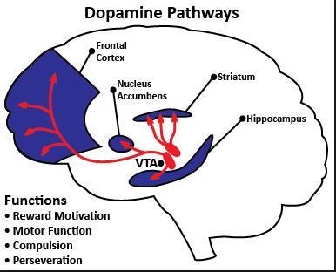
What are HPRT1’s GO terms?
Biological Processes
Molecular Functions
Cellular Components
Neuron development and differentiation
Purine Salvage Pathway
Dopamine metabolism
Dendrite morphogenesis
Locomotory behavior
Nucleotide binding
Phosphribosyltransferase activity
Magnesium ion binding
Cytoplasm
Notes:
Dopamine functions in reward motivation, motor function, and compulsive behavior

Slide 8
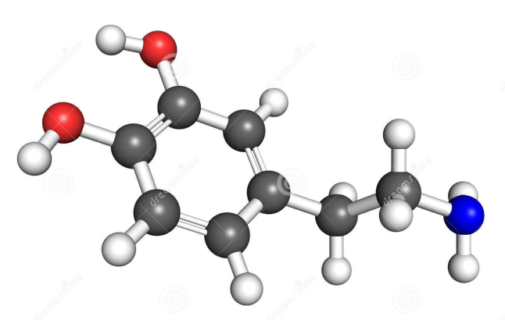
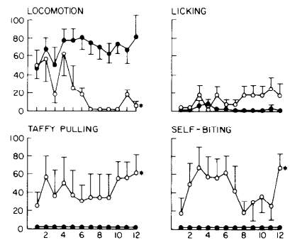
Dopamine
Pharmacological Rat Model Reduce brain dopamine in neonatal rats using neurotoxin 6-OHDA
Pleasure
Reward motivation
Motor function
Compulsive behavior
**LNS phenotypes may be caused by abnormal brain development, induced by low dopamine levels neonatally
Notes:
LNS phenotypes could be related to dysfunction of dopamine neurotransmitter system.
Score vs time (on graph)
Self-injury and locomotion phenotypes occurred ONLY when dopamine reduced in neonatal rats, not when reduced in adult rats (see graph above)
**Suggests that dopamine is critical for normal brain development → abnormal brain development (by lowering dopamine neonatally) produced LNS phenotypes!
**LNS appears to be a developmental disorder rather than a neurodegenerative disorder (like autism rather than Alzheimer’s)

Slide 9
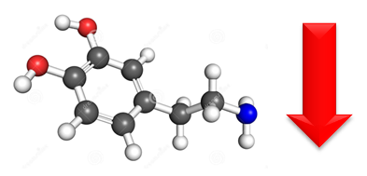
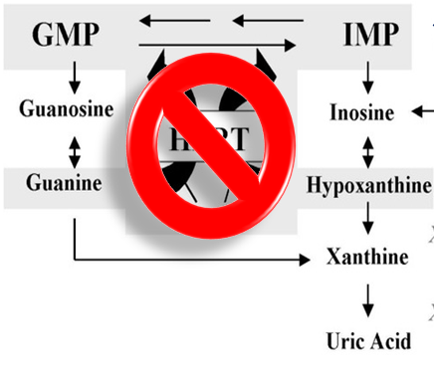
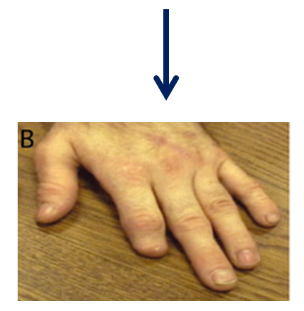
Gap in Knowledge

Slide 10
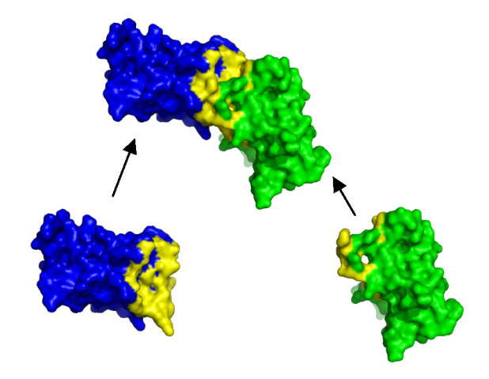
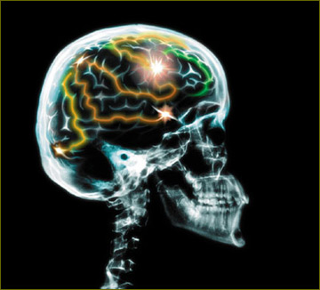
Hypothesis and Primary Goal
Hypothesis: HPRT1 regulates the development of the dopaminergic system, important for normal cognition and behavior, through protein interactions in the brain.
Primary Goal: Determine the genomic and proteomic changes that contribute to LNS neurological dysfunction as a result of loss-of-function mutations in HPRT1.

Slide 11
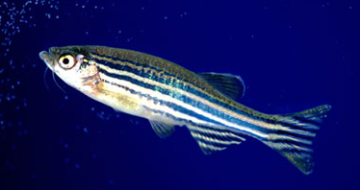
Zebrafish: A Model Organism for LNS
91% identity to human HPRT
Contains many of the same brain structures and developmental features as humans
Dopamine is important in brain function and development, as in humans
Cheap and easy to grow on a large-scale
Short, rapid development
Transparent development

Slide 12
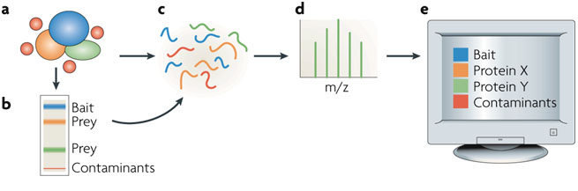
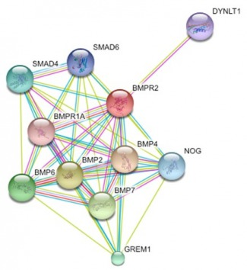
Specific Aim #1: Identify proteins that interact with HPRT
Affinity purification- mass spectrometry
(AP-MS)
STRING database
Determine function of HPRT interaction partners

Slide 13
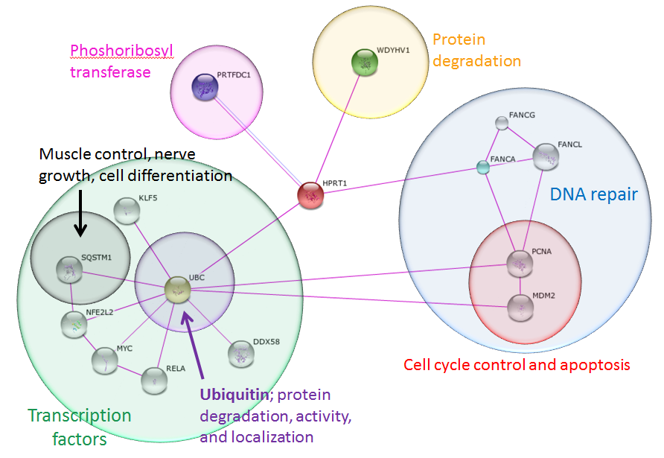
Specific Aim #1: Identify proteins that interact with HPRT
**SQSTM1 activates NF-KB (synaptic plasticity & dendrite growth), NGF (nerve growth), and titin/TTN (linked to movement disorders)
Notes:
Since purines are precursors for DNA, RNA, and energy molecules, HPRT clearly has a tacit effect on cell growth, division, and energy metabolism.
UBC is one of four sources of ubiquitin in the human genome and directs protein degradation, activity, and localization in cells. UBC is also associated with the regulation of many other cell signaling pathways.
SQSTM1, regulates the activation of NF-KB, nerve growth factor (NGF), and plays a role in titin/TTN downstream signaling in muscle cells. NGF is important for the growth, maintenance, and survival of nerve cells. NF-KB has been shown to regulate synaptic plasticity and the growth of dendrites. Titin/TTN is essential in providing structure, flexibility, and stability to muscle cell fibers. Disorders in movement, including muscular dystrophy, are often the result of mutations in titin/TTN.
Possible explanation: UBC adds ubiquitin to proteins, including HPRT and SQSTM1, to mark them for degradation. HPRT is highly expressed in all cells and therefore normally sequesters much of the free UBC. In patients with LNS, HPRT is absent. In these cases, UBC is released and allowed to degrade other proteins, including SQSTM1, keeping these proteins at lower levels. If SQSTM1 acts to increase the growth, survival, and plasticity of neurons and muscles, then decreasing SQSTM1 may cause the phenotypes associated with LNS!
***Confirming that these proteins are truly up- or down-regulated in LNS requires using mass spectrometry (MS) to quantify the relative amounts of these proteins in healthy people compared to LNS patients. (Segue into Specific Aim #2)

Slide 14
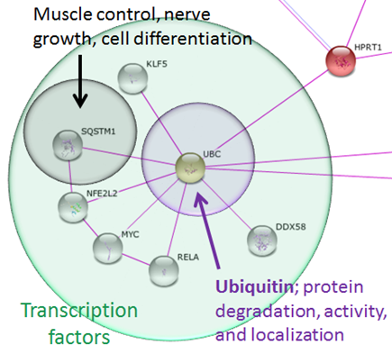
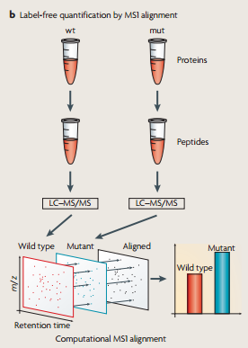
Specific Aim #2: Determine which proteins are over- or under-expressed in HPRT1-mutant zebrafish
Quantitative mass spectrometry:
Compare protein levels in wild-type and HPRT-mutant zebrafish
**Hypothesis: SQSTM1 decreases in HPRT mutants
Notes:
Once we identify proteins that interact with HPRT and could create LNS phenotypes, then we need to show that their levels are actually altered.

Slide 15
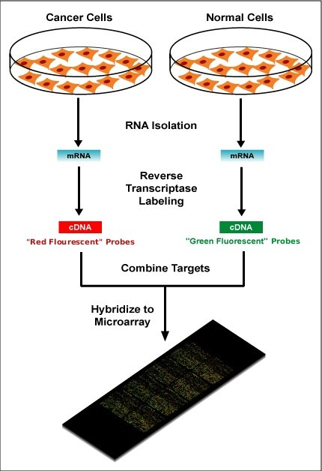
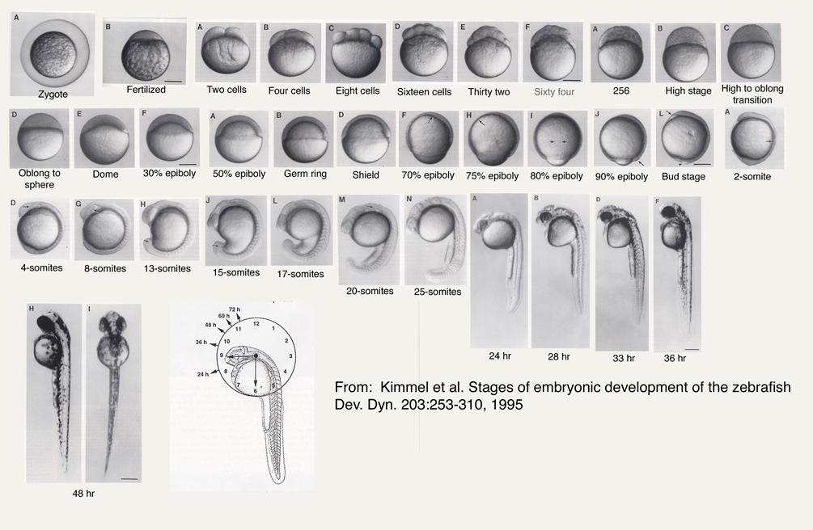
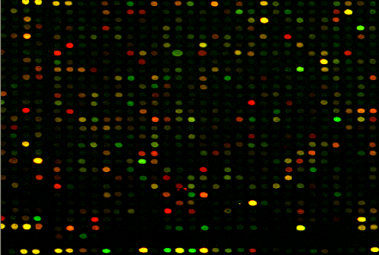
Specific Aim #3: Determine how gene expression levels change during neuronal brain development in HPRT-mutant zebrafish
HPRT-mutant
DNA microarray of brain cells at each stage of development
**Indicate when mutations in HPRT1 alter neuronal gene function, indicating how brain development may be altered
Notes:
DNA microarray to quantify the expression levels of all genes in the brains of wild-type and HPRT1-mutant zebrafish at each stage of development, from fertilization through adulthood.
**Indicates when mutations in HPRT1 alter neuronal gene function, indicating how brain development may be altered.
…clear that mRNA levels poorly correlate with protein abundance
-Schwanha¨ usser B, Busse D, Li N, Dittmar G, Schuchhardt J, Wolf J, Chen W, Selbach M: Global quantification of mammalian gene expression control. Nature 2011, 473:337-342.

Slide 16
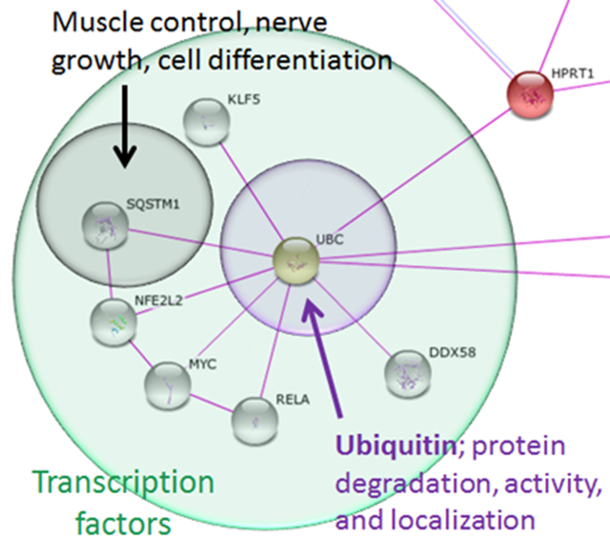
Conclusions Future Directions
These aims are expected to indicate how gene expression and protein interactions change as a of HPRT mutations.
Gain insight into the mechanisms that lead to the neuronal-behavioral phenotypes of LNS.
Alter levels of SQSTM1 and other proteins that interact with HPRT1. Observe if neurological or behavioral LNS phenotypes appear in mice.

Slide 17
Image URLs and References
http://www.gnet.org/wp-content/uploads/explained-got-disease.jpg
http://www.keystonekidney.com/images/about-kidney-stones.gif
http://simple-health-secrets.com/wp-content/uploads/2013/06/Lesch-Nyhan-Syndrome-4.jpg
http://medicalpictures.net/wp-content/uploads/2010/10/Lesch-Nyhan-Syndrome-pictures-3.jpg
http://www.ojrd.com/content/2/1/48/figure/F1
http://4.bp.blogspot.com/-IZrB3OKIHH8/Uo7dqy5kLSI/AAAAAAAAABA/2ahaXRkqelg/s72-c/leshnyhan.jpg
http://www.movementdisorders.org/MDS-Files1/Journals/Images/CPJ-Volume-1-Issue-3/mdc312040-fig-0001.png
http://www.cdb.riken.jp/jp/04_news/annual_reports/2006/WebHelp/common/lab1_07hlfig2.htm
http://drrajivdesaimd.com/wp-content/uploads/2013/06/dopamine-pathways.jpg
http://www.stats.ox.ac.uk/~hamer/images/complex.png
http://www.posturologiaclinica.net/img/rx_cranio_brain_02.jpg
http://www.nature.com/nrm/journal/v8/n8/images/nrm2208-f1.jpg
http://transforming-science.com/wp-content/uploads/2013/12/Zebrafish-aquarium.-010.jpg
http://kimgen677s10.weebly.com/uploads/3/6/1/8/3618941/290277.jpg?325
http://upload.wikimedia.org/wikipedia/en/thumb/c/c8/Microarray-schema.jpg/220px-Microarray-schema.jpg
https://denisezannino.files.wordpress.com/2013/07/zebrafish-kimmel.jpg
http://cdn.superbwallpapers.com/wallpapers/3d/mechanism-15796-1920x1200.jpg
Torres RJ and Puig JG. (2007). Hypoxanthine-guanine phosophoribosyltransferase (HPRT) deficiency: Lesch-Nyhan syndrome. Orphanet Journal of Rare Diseases, 2, 48. doi:10.1186/1750-1172-2-48
Torres RJ, Mateos FA, Molano J, Gathoff BS, O'Neill JP, Gundel RM, Trombley L, Puig JG. (2000). Molecular basis of hypoxanthine-guanine phosphoribosyltransferase deficiency in thirteen Spanish families. Hum Mutat,15, 383.
Jinnah HA, De Gregorio L, Harris JC, Nyhan WL, O'Neill JP. (2000). The spectrum of inherited mutations causing HPRT deficiency: 75 new cases and a review of 196 previously reported cases. Mutat Res, 463, 309-326.
Breese GR, Criswell HE, Duncan GE, Mueller RA. (1990). A dopamine deficiency model of Lesch-Nyhan disease – the neonatal-6-OHDA-lesioned rat. Brain Res Bull, 25, 477-484. DOI: 10.1016/0361-9230(90)90240-Z
Ernst M, Zametkin AJ, Matochik JA, Pascualvaca D, Jons PH, Hardy C, Hankerson JG, Doudet DJ, Cohen RM. (1996). Presynaptic dopaminergic deficits in Lesch-Nyhan disease. New Engl. J Med, 334, 1568-1572. DOI: 10.1056/NEJM199606133342403
"Lesch-Nyhan syndrome". Genetics Home Reference. US National Library of Medicine, Feb. 2013. Web. 24 Jan. 2015.
"Lesch-Nyhan Syndrome". NYU Langone Medical Center. Aug. 2014. Web. 25 Jan. 2015.
"Gout". Mayo Clinic. 25 Nov. 2014. Web. 24 Jan. 2015.
García PJ, Torres JR, Mateos F, Ramos T, Arcas J, Buño A, O'Neill P. (2001). The spectrum of Hypoxanthine-Guanine Phosphoribosyltransferase (HPRT) deficiency. Clinical experience based on 22 patients from 18 Spanish families. Medicine (Balt), 80, 102-112.
"Dystonias Fact Sheet". National Institute of Neurological Disorders and Stroke. 12 Nov. 2014 Web. 24 Jan. 2015.
Schretlen DJ, Harris JC, Park KS, Jinnah HA, del Pozo NO. (2001). Neurocognitive functioning in Lesch-Nyhan disease and partial hypoxanthine-guanine phosphoribosyltransferase deficiency. J Int Neuropsychol Soc, 7, 805-812.
Anderson LT, Ernst M. (1994). Self-injury in Lesch-Nyhan disease. J Autism Dev Disord, 24, 67-81.
Davidson BL, Tarle SA, Palella TD, Kelley WN. (1989). Molecular basis of hypoxanthine-guanine phosphoribosyltransferase deficiency in ten subjects determined by direct sequencing of amplified transcripts. J Clin Invest, 84, 342-346.
Olson L, Houlihan D. (2000). A review of behavioral treatments used for Lesch-Nyhan syndrome. Behav Modif, 24, 202-222.
Gene Ontology Consortium. An Introduction to the Gene Ontology. Accessed 26 February 2015.
Herron, J.C. and Freeman S. (2014). Evolutionary Analysis: Fifth Edition. Glenview, IL: Pearson Education, Inc.
Delsuc F, Brinkmann H, Philippe H. (2005). Phylogenomics and the reconstruction of the tree of life. Nat Rev Genet 6:361-375.
About BLAST http://www.ncbi.nlm.nih.gov/books/NBK1734/
Gingras AC, Gstaiger M, Raught B, and Aebersold R. (2007). Analysis of protein complexes using mass spectrometry. Nat Rev Mol Cell Biol, 19(4), 645-654.

