Slide 1
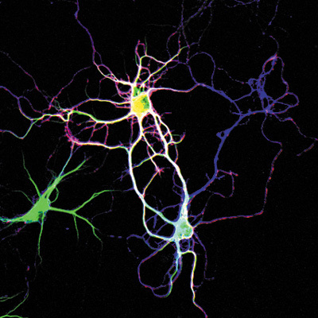
Lesch-Nyhan Syndrome (LNS) and the HPRT1 Gene
Billy Maes

Slide 2
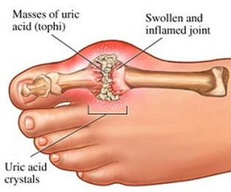
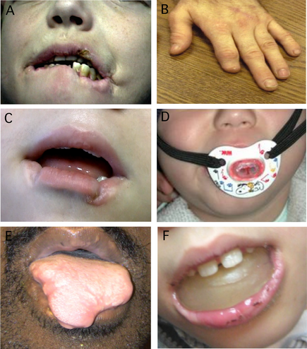
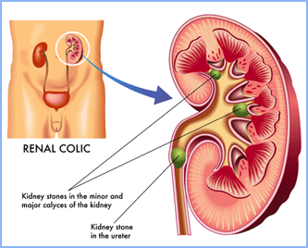
What is Lesch-Nyhan Syndrome?
Gouty arthritis
Kidney stones
Loss of motor control
Cognitive problems
Self-Injury
Notes:
X-linked recessive disease caused by a severe deficiency of hypoxanthine-guanine phosphoribosyltransferase (HPRT) → recycles purines for reuse as DNA in cells.
HPRT loss causes overproduction of uric acid → gouty arthritis and kidney stones (known mechanism);
Only occur in patients with complete loss of HPRT function (unknown mechanism):
Motor control (involuntary muscle contractions, unable to stand/walk);
Cognitive problems (varying levels of mental retardation)
Self-Injury (biting through lips, tongue, fingers, and other body parts; head banging, eye gouging, etc.)

Slide 3
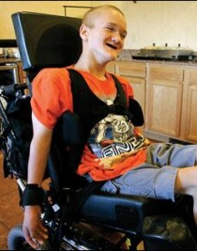
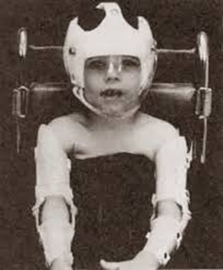
What is Lesch-Nyhan Syndrome?
https://www.youtube.com/watch?v=1U6LDpF_LFE

Slide 4
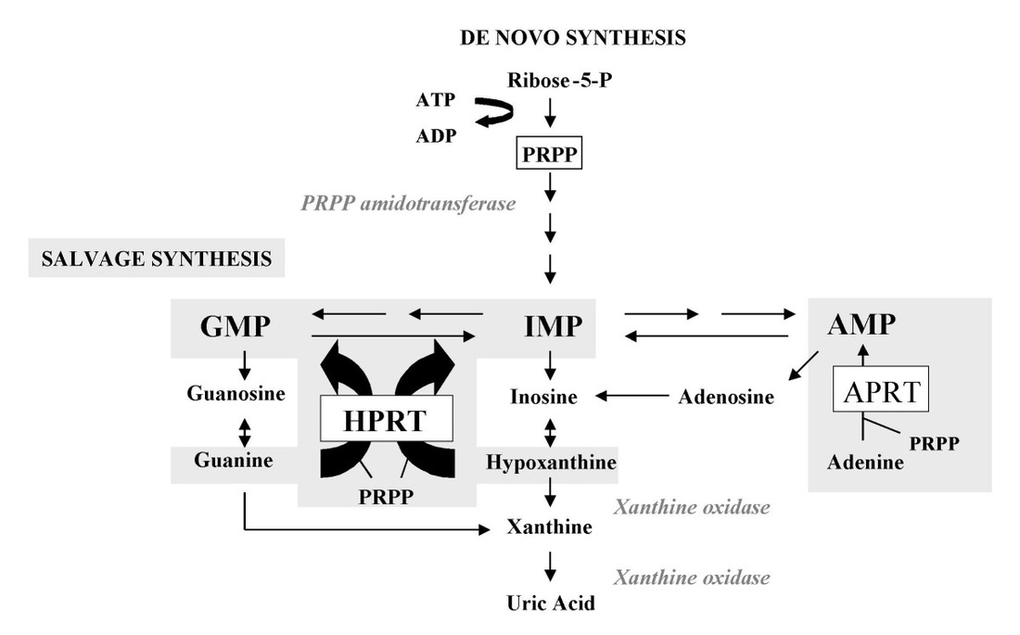
What causes Lesch-Nyhan Syndrome?
Excess uric acid → gout and kidney stones
**Unknown mechanism → neurological symptoms
Notes:
Included entire pathway in image because it’s important to recognize that changes in the levels of one substrate can have amplifying effects across the entire pathway.

Slide 5
>300 mutations in HPRT1 are known to cause LNS
Point mutations
Loss-of-function mutations
Change in size, shape
HPRT1 gene
Notes:
More than 300 different mutations have been found to cause LNS to date. Single point mutations generally cause partial HPRT deficiency, but mutations that modify the size, shape, and therefore function of the wild-type HPRT enzyme cause LNS.

Slide 6
How well conserved is HPRT?
Human
Phosphoribosyl transferase domain
218 aa
% Identity
Mouse
218
97%
Chicken
218
91%
Zebrafish
218
91%
Roundworm
214
49%
Arabidopsis
188
31%

Slide 7
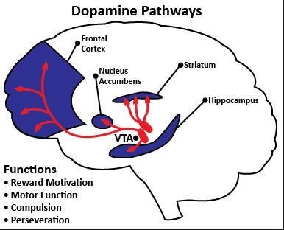
What are HPRT1’s GO terms?
Biological Processes
Molecular Functions
Cellular Components
Neuron development and differentiation
Purine Salvage Pathway
Dopamine metabolism
Dendrite morphogenesis
Locomotory behavior
Nucleotide binding
Phosphribosyltransferase activity
Magnesium ion binding
Cytoplasm
Notes:
Dopamine functions in reward motivation, motor function, and compulsive behavior

Slide 8
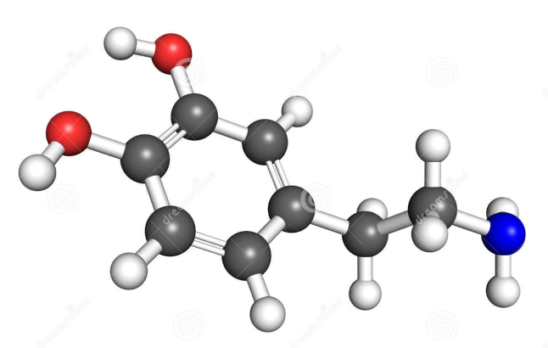
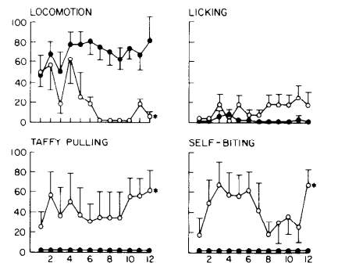
Dopamine
Pharmacological Rat Model Reduce brain dopamine in neonatal rats using neurotoxin 6-OHDA
Pleasure
Reward motivation
Motor function
Compulsive behavior
**LNS phenotypes may be caused by abnormal brain development, induced by low dopamine levels neonatally
Notes:
LNS phenotypes could be related to dysfunction of dopamine neurotransmitter system.
Score vs time on graph
Self-injury and locomotion phenotypes occurred ONLY when dopamine reduced in neonatal rats, not when reduced in adult rats (see graph above)
**Suggests that dopamine is critical for normal brain development → abnormal brain development (by lowering dopamine neonatally) produced LNS phenotypes!
**LNS appears to be a developmental disorder rather than a neurodegenerative disorder (like autism rather than Alzheimer’s)

Slide 9
Gap in Knowledge

Slide 10
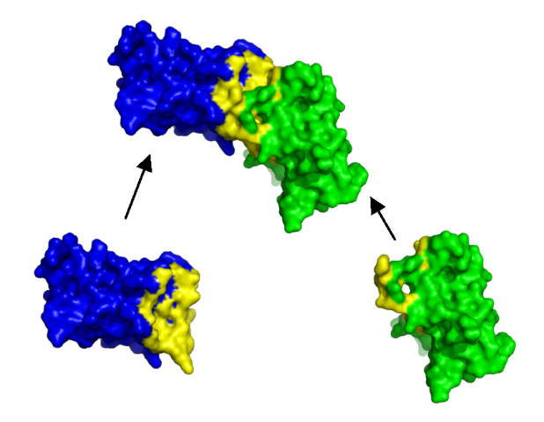
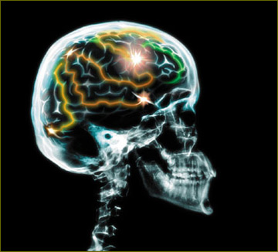
Hypothesis and Primary Goal
Hypothesis: Loss of HPRT function alters the development of the dopaminergic system by changing protein interactions in the brain.
Primary Goal: Characterize the genomic and proteomic changes that contribute to LNS neurological dysfunction as a result of loss-of-function mutations in HPRT1.

Slide 11
Specific Aim #1: Determine which proteins interact with HPRT in wild-type mice
*Note to Ahna and TAs: I haven’t filled in my specific aims yet because (1) I’m still tweaking them, (2) I may change one of them to use a new technique soon, and (3) I have yet to actually do or attempt any of these experiments, so I didn’t want to include information that would become useless later. Also, I submitted this to the website on March 19th, so my lack of info is not from running out of time last minute.

Slide 12
Specific Aim #2: Establish how gene expression levels change in purine salvage pathway as a result of mutations in HPRT1

Slide 13
Specific Aim #3: Identify proteins that are over- or under-expressed in HPRT1-mutant mice

Slide 14
Conclusions and Future Directions

Slide 15
References
http://www.gnet.org/wp-content/uploads/explained-got-disease.jpg
http://www.keystonekidney.com/images/about-kidney-stones.gif
http://simple-health-secrets.com/wp-content/uploads/2013/06/Lesch-Nyhan-Syndrome-4.jpg
http://medicalpictures.net/wp-content/uploads/2010/10/Lesch-Nyhan-Syndrome-pictures-3.jpg
http://www.ojrd.com/content/2/1/48/figure/F1
http://4.bp.blogspot.com/-IZrB3OKIHH8/Uo7dqy5kLSI/AAAAAAAAABA/2ahaXRkqelg/s72-c/leshnyhan.jpg
http://www.movementdisorders.org/MDS-Files1/Journals/Images/CPJ-Volume-1-Issue-3/mdc312040-fig-0001.png
http://www.cdb.riken.jp/jp/04_news/annual_reports/2006/WebHelp/common/lab1_07hlfig2.htm
http://drrajivdesaimd.com/wp-content/uploads/2013/06/dopamine-pathways.jpg
http://www.stats.ox.ac.uk/~hamer/images/complex.png
http://www.posturologiaclinica.net/img/rx_cranio_brain_02.jpg
Torres RJ and Puig JG. (2007). Hypoxanthine-guanine phosophoribosyltransferase (HPRT) deficiency: Lesch-Nyhan syndrome. Orphanet Journal of Rare Diseases, 2, 48. doi:10.1186/1750-1172-2-48
Torres RJ, Mateos FA, Molano J, Gathoff BS, O'Neill JP, Gundel RM, Trombley L, Puig JG. (2000). Molecular basis of hypoxanthine-guanine phosphoribosyltransferase deficiency in thirteen Spanish families. Hum Mutat,15, 383.
Jinnah HA, De Gregorio L, Harris JC, Nyhan WL, O'Neill JP. (2000). The spectrum of inherited mutations causing HPRT deficiency: 75 new cases and a review of 196 previously reported cases. Mutat Res, 463, 309-326.
Breese GR, Criswell HE, Duncan GE, Mueller RA. (1990). A dopamine deficiency model of Lesch-Nyhan disease – the neonatal-6-OHDA-lesioned rat. Brain Res Bull, 25, 477-484. DOI: 10.1016/0361-9230(90)90240-Z
Ernst M, Zametkin AJ, Matochik JA, Pascualvaca D, Jons PH, Hardy C, Hankerson JG, Doudet DJ, Cohen RM. (1996). Presynaptic dopaminergic deficits in Lesch-Nyhan disease. New Engl. J Med, 334, 1568-1572. DOI: 10.1056/NEJM199606133342403
"Lesch-Nyhan syndrome". Genetics Home Reference. US National Library of Medicine, Feb. 2013. Web. 24 Jan. 2015.
"Lesch-Nyhan Syndrome". NYU Langone Medical Center. Aug. 2014. Web. 25 Jan. 2015.
"Gout". Mayo Clinic. 25 Nov. 2014. Web. 24 Jan. 2015.
García PJ, Torres JR, Mateos F, Ramos T, Arcas J, Buño A, O'Neill P. (2001). The spectrum of Hypoxanthine-Guanine Phosphoribosyltransferase (HPRT) deficiency. Clinical experience based on 22 patients from 18 Spanish families. Medicine (Balt), 80, 102-112.
"Dystonias Fact Sheet". National Institute of Neurological Disorders and Stroke. 12 Nov. 2014 Web. 24 Jan. 2015.
Schretlen DJ, Harris JC, Park KS, Jinnah HA, del Pozo NO. (2001). Neurocognitive functioning in Lesch-Nyhan disease and partial hypoxanthine-guanine phosphoribosyltransferase deficiency. J Int Neuropsychol Soc, 7, 805-812.
Anderson LT, Ernst M. (1994). Self-injury in Lesch-Nyhan disease. J Autism Dev Disord, 24, 67-81.
Davidson BL, Tarle SA, Palella TD, Kelley WN. (1989). Molecular basis of hypoxanthine-guanine phosphoribosyltransferase deficiency in ten subjects determined by direct sequencing of amplified transcripts. J Clin Invest, 84, 342-346.
Olson L, Houlihan D. (2000). A review of behavioral treatments used for Lesch-Nyhan syndrome. Behav Modif, 24, 202-222.
Gene Ontology Consortium. An Introduction to the Gene Ontology. Accessed 26 February 2015.
Herron, J.C. and Freeman S. (2014). Evolutionary Analysis: Fifth Edition. Glenview, IL: Pearson Education, Inc.
Delsuc F, Brinkmann H, Philippe H. (2005). Phylogenomics and the reconstruction of the tree of life. Nat Rev Genet 6:361-375.
About BLAST http://www.ncbi.nlm.nih.gov/books/NBK1734/

